Slide 1
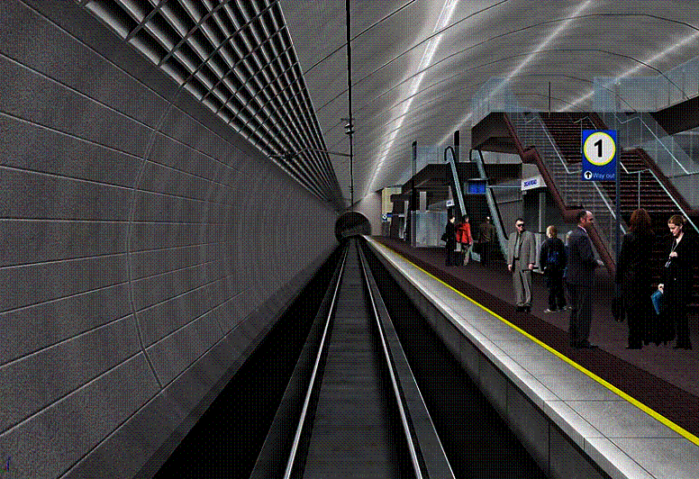
OMNIVIEW
FFCCTV COLOUR NIGHT VISION
ENHANCING SECURITY & SURVEILLANCE
GUIDING LIGHTS TECHNOLOGY
INTRODUCTION TO THE
FORWARD FACING CCTV COLOUR NIGHT VISION CAMERA
For Drivers Cab to Enhance Rail Security & Surveillance and Reduce
cost of delays caused by Suicide - Assaults – Threats
Copper cable theft & Vandalism
THE FORWARD FACING CAMERA SYSTEM THAT RECORDS IN HIGH DEFINITION COLOUR
DURING DAYLIGHT AND NIGHT TIME, PROVIDING ESSENTIAL, QUALITY EVIDENCE OF:
SUICIDES – ASSAULTS – THREATS - VANDALISM - CABLE THEFT
OPERATIONAL INCIDENTS, ACCIDENTS
SECURITY AND SURVEILLANCE, SAFETY, LEGAL PROCEEDINGS, DRIVER TRAINING

Slide 2

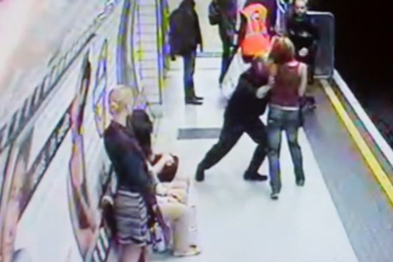
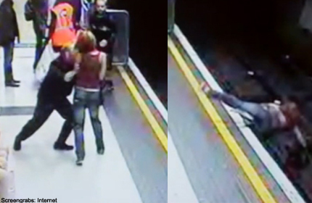
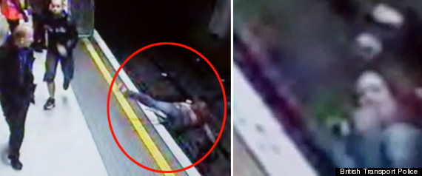
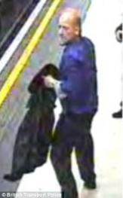

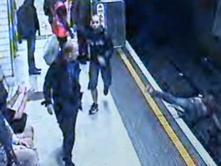
IN THE CASE OF SUICIDES OR ASSAULTS, SUCH AS THE ONE BELOW,
STANDARD CCTV MAKES IDENTIFICATION DIFFICULT. THE “IVT” HD FFCCTV CAMERA WITH COLOUR NIGHT VISION WOULD PROVIDE TRANSIT POLICE WITH CRYSTAL CLEAR QUALITY EVIDENCE

Slide 3
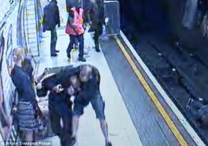
SUICIDE, ACCIDENT OR ASSAULT?
THIS CAN DETERMINE IF THE TRAIN IS TREATED AS A CRIME SCENE AND TAKEN OUT OF VALUABLE REVENUE GENERATING SERVICE!
THE CAMERA WILL PROVIDE EVIDENCE IN THE CASE OF A SUICIDE OR AN ASSAULT. THE RECORDING WILL SHOW IF THE VICTIM SLIPPED AND FELL OR ANY OTHER PARTY WAS INVOLVED IN THE DEATH.
THE EVIDENCE CAN ALSO HELP PROVIDE SOME CLOSURE TO THE VICTIMS’ FAMILY. THE DRIVER OF THE TRAIN WILL ALSO BENEFIT WITH SOME EVIDENCE TO PROVE THE INCIDENT WAS UNAVOIDABLE.

Slide 4
SECURITY & SURVEILLANCE
BRITISH TRANSPORT POLICE, HOMELAND SECURITY APPLICATIONS
Importantly, the OmniView forward facing HD quality CCTV System can be used by British Transport Police, Homeland Security, FBI, NTSB and other Government Agencies, to enhance Passenger Safety and Public Security in the UK and North America.
It can be used an as Anti-Terrorist tool to combat potential threats to Rail Transportation Systems.
The facial recognition capability would enable identification of known vandals or persons of interest on an agency watch list.
The Omniview CCTV System has been developed in co-operation with a leading UK Train Operating Company (TOC) to identify incidents and accidents occurring within the path of the vehicle, the system records in real time the events witnessed by the driver.

Slide 5
Suicides in the UK Rail Industry have increased and the cost of delays is reported to be approaching those caused by Copper Cable Theft WHICH IS £43M over 3 years
Suicides. (A PERSON JUMPS ONTO THE TRACKS – 260 LAST YEAR)
Accident. (A Person “fell” onto the tracks)
Assault / Attempted murder. (A Person was pushed onto tracks but survived)
Murder. (A Person was intentionally pushed onto the tracks and was killed) (AS IN 2 recent cases on THE new York subway)
THE ABOVE incidents that occur on station platforms may not be captured clearly by current CCTV cameras, due to their location. THEREFORE, THE LOCATION MAY BE TREATED AS A CRIME SCENE CAUSING LONG DELAYS SIGNIFICANTLY INCREASING COSTS.
Although Train drivers are professional and well trained, they are not prepared for the psychological aftermath of a suicide jumper or any other fatal incidents
In some cases drivers are required to attend a coroner's inquest. They can be questioned by the deceased's relatives at length, and made to relive details of the fatality in graphic detail. the video from THE HD FFCCTV COLOUR NIGHT VISION camera in the drivers cab would give a “drivers eye view” and provide immediate “quality evidence” FOR BRITISH TRANSPORT POLICE TO DETERMINE IF THE INCIDENT IS A CRIME SCENE OR NOT. This evidence may also reduce the need for the driver to attend a coroners inquest and assist in their recovery and return to work
Reducing Delays and Costs Related to
Suicide – Assault – Attempted Murder - Murder

Slide 6
COPPER CABLE THEFT £43M IN THE UK RAIL INDUSTRY
THE PROBLEM:
According to the British Transport Police in the last 3 years, cable theft has cost the rail industry £43million, delaying trains for a total of more than 16,000 hours.
In June cable thieves disabled the signalling system near Woking in Surrey, causing massive disruption for around 80,000 passengers in the evening rush hour.
Disabled signals can cause SPAD’s (Signals Passes at Danger (threatening the safety of passengers and public)
Ministers have said they are looking at new measures to combat the problem and are being urged to give police greater powers and to tighten regulation of scrap metal dealers.
British Transport Police said it had 110 officers working full time on the problem as it was aware it was having a "very significant" effect on communities and businesses.
A mere 30ft of cabling had been stolen overnight from beside the track outside London Bridge, yet the disruption was staggering – over 1,650 trains were delayed, at a cost to Network Rail of £640,000, and the quiet fury of thousands of paying passengers. It took all day to get the trains running properly again.
Drivers are briefed to report "suspicious activity" on the network amid evidence that thieves were pretending to be engineering staff in order to gain access to the railway.
However, the primary responsibility of the driver is the safe operation of the train and passenger safety. Human Factors will prove that tasking the driver to look for and report “suspicious activity” can increase the risk of Human Error and accidents. Human Error is the cause of one-third of all rail accidents in North America.

Slide 7
COPPER CABLE THEFT £43M IN THE UK RAIL INDUSTRY
THE SOLUTION – COVERT FFCCTV SECURITY OPERATIONS:
Assist the driver’s by installing Forward Facing CCTV Camera’s to the window of the drivers cab, with Colour Nigh Vision capability. It records everything the driver sees and facilitates a police response in minutes with GPS location of the theft, day or night. It will provided 24X7 security to Network Rails entire operations!
REDUCTION OF COPPER CABLE THEFT:
The recording provides Rail Transit Police with quality video evidences to identify suspicious persons or those involved in copper cable theft.
The recording can also be used by Homeland Security, FBI, NTSB and other Government Agencies, to enhance public transportation safety.
It can be used an as Anti-Terrorist tool to combat potential threats to Rail Transportation Systems.
The facial recognition capability would enable identification of known vandals or persons of interest on an agency watch list.
Guiding Lights Technology (GLT) is currently working with the rail industry in North America and the UK to develop the HD quality Forward Facing CCTV camera with Colour Night Vision for their Training and Security requirements

Slide 8
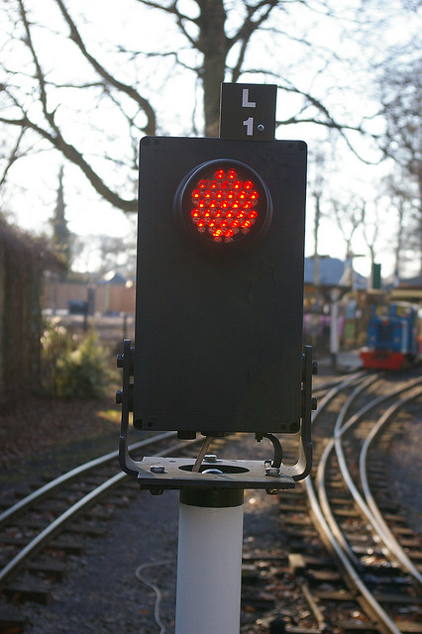
SIGNALS PASSED AT DANGER (SPADS):
Last year there were 278 SPAD’s
Average Delay was 8.5 minutes per SPAD.
A CAMERA RECORDING WILL SHOW (IN HIGH DEFINITION) THE SIGNAL SEQUENCES APPROACHING THE INCIDENT, ALLOWING MANAGEMENT TO CLEARLY IDENTIFY WHETHER THE SIGNAL FAILED, IF THE LIGHTING SEQUENCE WAS INCORRECT OR IF THE DRIVER SIMPLY DIDN’T STOP. THIS QUALITY EVIDENCE WILL ALLOW THE ISSUE TO BE RESOLVED QUICKLY AND AT A MUCH LOWER COST DUE TO REDUCED DOWN TIME OF THE LINE.
IMPORTANTLY, IF A SPAD INCIDENT OCCURS IN A SUBWAY TUNNEL, OR AT NIGHT, THE COLOUR NIGHT VISION CAPABILITY OF THE FFCCTV CAMERA WILL CLEARLY SHOW THE COLOUR OF THE SIGNAL, UNLIKE MOST NIGHT VISION CAMERA’S WHICH ARE BLACK AND WHITE, AND OFTEN INCONCLUSIVE.
THERE ARE MANY ADVANTAGES TO USING THE “IVT” FFCCTV SYSTEM WITH THEIR PROPRIETORY DRIVER TRAINING SOFTWARE, INCLUDING:

Slide 9
VANDALISM:
SHOULD ANY VANDALISM OCCUR ON THE LINE THE CAMERA COULD PROVIDE EVIDENCE. THE CAMERA WILL ALSO HELP IDENTIFY CULPRITS WHO THROW MISSILES FROM BRIDGES TOWARDS THE TRAIN.
INCIDENT MANAGEMENT:
THE PLAYBACK SOFTWARE ALLOWS INCIDENTS TO BE REVIEWED QUICKLY AND EASILY. IF NO CAMERA WAS AVAILABLE MANAGEMENT WOULD ONLY HAVE A DRIVERS’ RECOLLECTION OF EVENTS. WITH THE ADDITION OF A CAMERA TANGIBLE EVIDENCE IS AVAILABLE TO BACK UP THE DRIVERS DESCRIPTION OF EVENTS.
DRIVER TRAINING:
ALONG SIDE THE EVIDENCE REPORTING THE CAMERA CAN ALSO BE USED TO TRAIN DRIVERS ON NEW ROUTES USING THE PLAY BACK SOFTWARE. THIS CAN ALSO HELP RETRAIN A DRIVER WHO MAY HAVE A POOR DRIVING TECHNIQUE.
FUEL EFFICIENCY:
THE PLAYBACK SOFTWARE CAN PROVIDE A SPEED/TIME CURVE TO IDENTIFY AREAS OF RAPID ACCELERATION/DECELERATION. THE GRAPHS CAN SHOW IF A DRIVER IS DRIVING IN A FUEL EFFICIENT MANNER.

Slide 10
THE OMNIVIEW HIGH DEFINITION FFCCTV CAMERA WITH COLOUR NIGHT VISION CAN PROVIDE TRANSIT POLICE WITH CRYSTAL CLEAR VIDEO AND AUDIO. THE CLARITY WOULD ENABLE A STILL PHOTO FRAME FROM
THE VIDEO TO BE RUN THROUGH A FACIAL RECOGNITION DATA BASE.
THE RECORDED DATA CAN PROVIDE EVIDENCE IN THE CASE OF;
SUICIDE - COPPER CABLE THEFT
COLLISIONS – ASSAULTS - SIGNALS PASSED AT DANGER
– VANDALISM – THREATS – FIRE – FLOODING
FOLIAGE OBSTRUCTING SIGNALS - TRACK CONDITIONS - OBSTRUCTIONS.

Slide 11
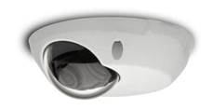
OVERVIEW:
IVT HAVE WORKED WITH A WELL KNOWN INTERNATIONAL CAMERA MANUFACTURER TO PROVIDE A CAMERA THAT WILL MEET THE DEMANDS OF THE SPECIFIC REQUIREMENTS OF THE RAIL AND BUS TRANSPORTATION INDUSTRY. MOST CCTV CAMERAS WILL ONLY RECORD IN MONO IN POOR LIGHT CONDITIONS. OUR CAMERA, DESIGNED SPECIFICALLY FOR THE PURPOSE, WILL RECORD COLOUR IN BOTH DAY AND NIGHT CONDITIONS, AN ESSENTIAL FEATURE FOR PROVIDING EVIDENCE AT SIGNALS.
IVT Hardware Features
Digital CCTV Camera - Image Resolution 1280 x 800
Storage: 500GB SSD Hard Drive - Recording Time: Approx. 250 Hours
GPS provides Position Information - GPRS Allows Remote Vehicle Tracking

Slide 12
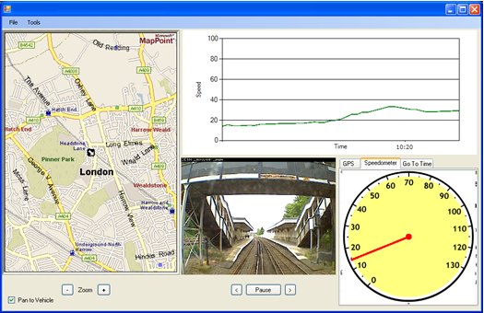
THE SYSTEM ALSO RECORDS GPS DATA WHICH WILL ALLOW VEHICLE POSITION, SPEED AND DIRECTION INFORMATION TO BE TRANSMITTED TO A REMOTE LOCATION VIA THE USE OF A GPRS MODULE, ALLOWING TRACKING IN REAL TIME.
THE SYSTEM RECORDS IN HIGH DEFINITION (HD); GIVING A FAR SUPERIOR IMAGE OF THE DRIVERS’ VIEW COMPARED TO OTHER SYSTEMS. IMPORTANTLY, IN THE CASE OF VANDALISM OR OTHER THREATS, THIS WOULD ENABLE AN HD QUALITY STILL IMAGE TO BE TAKEN FROM THE VIDEO AND WITH FACIAL RECOGNITION TECHNOLOGY; SUSPECTS COULD BE IDENTIFIED IN MINUTES.
INTERROGATION SOFTWARE

Slide 13
OMNIVIEW FEATURES INCLUDE:
VIDEO PLAYBACK
GPS DATA REPLAY
CURRENT POSITION
DATE, TIME AND GPS POSITION ON EACH FRAME
GRAPHICAL DISPLAY OF SPEED
ACCELERATION AND BRAKING CURVES
ROUTE TRAINING AID
ACTUAL ARRIVAL AND DEPARTURE TIMES
The video footage is securely encrypted onto the recording unit and is only viewable with OmniView. This ensures footage cannot be seen during the transfer of the data, or by any unauthorised personnel. Once retrieved, the recorded data is loaded into OmniView, our analysis software. The drivers’ route can then be reviewed.

Slide 14
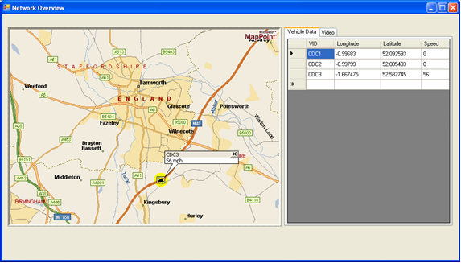
Real Time Information:
The system has the ability to transmit data to a remote server. This allows a depot manager to view the location of all the units and even access a live video feed. This will allow better management of incidents occurring on the rail network or bus route. The data could also be passed onto a client who wants to know the current location of a passenger or freight train, as well as the location of buses, traffic density, weather conditions etc. This information could assist avoid schedule delays.

Slide 15
The data is transmitted to a server using GSM/GPRS/3G. The data is stored and can be viewed on a map which displays all available vehicles. Should you wish to view the footage, selecting a vehicle will allow the software to connect to that vehicle and a low frame rate live feed will become available.

Slide 16
“IVT” FFCCTV COLOUR NIGHT VISION SYSTEM
SUMMARY OF BENEFITS ⁽¹⁾
FOR TRANSIT POLICE –COMBAT COPPER CABLE THEFT:
THE FFCCTV HD CAMERA RECORDS IN COLOUR BOTH DAY AND NIGHT TIME, AN ESSENTIAL FEATURE TO PROVIDE
EVIDENCE OF COPPER CABLE THEFT, ACCIDENTS OR ASSAULTS. IT CAN BE USED BY RAIL TRANSIT POLICE, HOMELAND SECURITY, FBI, NTSB AND OTHER GOVERNMENT AGENCIES, TO ENHANCE PASSENGER SAFETY & PUBLIC SECURITY
A FRAME FROM HD VIDEO COULD POTENTIALLY BE USED WITH A FACIAL RECOGNITION DATA BASE TO IDENTIFY KNOWN VANDALS OR PERSONS ON A WATCH LIST
FOR ROSCO’S:
PROTECTION OF ASSETTS
ASSET MANAGEMENT
EVIDENCE TO MITIGATE LIABILITY
GUIDING LIGHTS TECHNOLOGY INC

Slide 17
“IVT” FFCCTV COLOUR NIGHT VISION SYSTEM
SUMMARY OF BENEFITS ⁽²⁾
FOR UK TOC’S – DRIVER TRAINING:
EVIDENCE TO DETERMINE SUICIDE OR ATTEMPTED MURDER
AVOIDS TRAIN BEING TAKEN OUT OF SERVICE IF NOT A CRIME SCENE
DRIVER TRAINING ENHANCEMENT
EVIDENCE OF SIGNALS PASSED AT DANGER, ESPECIALLY IN TUNNELS OR AT NIGHT
VANDALISM
INCIDENT MANAGEMENT
FUEL EFFICIENCY
ROUTE FAMILIARIZATION
THE SYSTEM RECORDS GPS DATA AND ALLOWS REAL TIME VEHICLE POSITION, SPEED AND DIRECTION INFORMATION TO BE TRANSMITTED TO A REMOTE LOCATION VIA THE USE OF A GPRS MODULE.
THE VIDEO FOOTAGE IS SECURELY ENCRYPTED AND IS ONLY VIEWABLE WITH OMNIVIEW. THIS ENSURES FOOTAGE CANNOT BE SEEN DURING THE TRANSFER OF THE DATA, OR BY UNAUTHORISED PERSONNEL. ONCE RETRIEVED, THE DATA IS LOADED INTO OMNIVIEW, OUR ANALYSIS SOFTWARE.
GUIDING LIGHTS TECHNOLOGY INC

Slide 18
“IVT” FFCCTV COLOUR NIGHT VISION SYSTEM
SUMMARY OF BENEFITS ⁽³⁾
FOR UK TOC’S – FEATURES INCLUDE:
VIDEO PLAYBACK
GPS DATA REPLAY
CURRENT POSITION
DATE, TIME AND GPS POSITION ON EACH FRAME
GRAPHICAL DISPLAY OF SPEED
ACCELERATION AND BRAKING CURVES
ROUTE TRAINING AID
ACTUAL ARRIVAL AND DEPARTURE TIMES
THE IVT OMNIVIEW HD FFCCTV SYSTEM WITH COLOUR NIGHT VISION FOR THE RAIL, BUS AND TRANSIT POLICE OPERATIONS IS AVAILABLE IN THE UK AND NORTH AMERICA. SALES AND SERVICE SUPPORT IS PROVIDED 24X7 FROM OFFICES IN THE UK - TORONTO AND PHILADELPHIA. FOR ADDITIONAL INFORMATION PLEASE CONTACT:
GRAHAM STOKES. CHAIRMAN & CEO. GUIDING LIGHTS TECHNOLOGY
168 SPRINGHEAD GARDENS. RICHMOND HILL, ONTARIO, CANADA L4C 5C6
T: 905-508-1287 - MOBILE: 416-709-3800 EMAIL: grahamstokes@rodgers.com
GUIDING LIGHTS TECHNOLOGY INC

